Slide 1



Using Classes and Objects
http://csharpfundamentals.telerik.com
Using the Standard .NET Framework Classes
Telerik Software Academy
Learning & Development Team
http://academy.telerik.com

Slide 2

Table of Contents
Classes and Objects
What are Objects?
What are Classes?
Classes in C#
Declaring Class
Fields and Properties: Instance and Static
Instance and Static Methods
Constructors
Enumerations

Slide 3


Table of Contents (2)
Structures
Namespaces
Random class
Introduction to .NET Common Type System

Slide 4

Classes and Objects
Modeling Real-world Entities with Objects

Slide 5
What are Objects?
Software objects model real-world objects or abstract concepts
Examples:
bank, account, customer, dog, bicycle, queue
Real-world objects have states and behaviors
Account' states:
holder, balance, type
Account' behaviors:
withdraw, deposit, suspend

Slide 6

What are Objects? (2)
How do software objects implement real-world objects?
Use variables/data to implement states
Use methods/functions to implement behaviors
An object is a software bundle of variables and related methods

Slide 7
Objects Represent
 checks
 people
 shopping list
…
 numbers
 characters
 queues
 arrays
Things from the real world
Things from the computer world

Slide 8
What is a Class?
The formal definition of class:
Definition by Google
Classes act as templates from which an instance of an object is created at run time. Classes define the properties of the object and the methods used to control the object's behavior.

Slide 9
Classes
Classes provide the structure for objects
Define their prototype, act as template
Classes define:
Set of attributes
Represented by variables and properties
Hold their state
Set of actions (behavior)
Represented by methods
A class defines the methods and types of data associated with an object

Slide 10
Classes – Example
Class Name
Attributes
(Properties and Fields)
Account
+Owner: Person
+Ammount: double
+Suspend()
+Deposit(sum:double)
+Withdraw(sum:double)
Operations
(Methods)

Slide 11
Objects
An object is a concrete instance of a particular class
Creating an object from a class is called instantiation
Objects have state
Set of values associated to their attributes
Example:
Class: Account
Objects: Ivan's account, Peter's account

Slide 12
Objects – Example
Object
Class
ivanAccount
+Owner="Ivan Kolev"
+Ammount=5000.0
Account
+Owner: Person
+Ammount: double
Object
peterAccount
+Suspend()
+Deposit(sum:double)
+Withdraw(sum:double)
+Owner="Peter Kirov"
+Ammount=1825.33
Object
kirilAccount
+Owner="Kiril Kirov"
+Ammount=25.0

Slide 13


Classes in C#
Using Classes and their Class Members

Slide 14

Classes in C#
Classes – basic units that compose programs
Implementation is encapsulated (hidden)
Classes in C# can contain:
Fields (member variables)
Properties
Methods
Constructors
Inner types
Etc. (events, indexers, operators, …)

Slide 15

Classes in C# – Examples
Example of classes (structures):
System.Console
System.String (string in C#)
System.Int32 (int in C#)
System.Array
System.Math
System.Random
System.DateTime
System.Collections.Generics.List<T>

Slide 16
Declaring Objects
An instance of a class or structure can be defined like any other variable:
Instances cannot be used if they are not initialized
using System;
...
// Define two variables of type DateTime
DateTime today;
DateTime halloween;
// Declare and initialize a structure instance
DateTime today = DateTime.Now;

Slide 17

Fields and Properties
Accessing Fields and Properties

Slide 18

Fields
Fields are data members of a class
Can be variables and constants (read-only)
Accessing a field doesn’t invoke any actions of the object
Just accesses its value
Example:
String.Empty (the "" string)

Slide 19

Accessing Fields
Constant fields can be only read
Variable fields can be read and modified
Usually properties are used instead of directly accessing variable fields
Examples:
// Accessing read-only field
String empty = String.Empty;
// Accessing constant field
int maxInt = Int32.MaxValue;

Slide 20

Properties
Properties look like fields
Have name and type
Can contain code, executed when accessed
Usually used as wrappers
To control the access to the data fields
Can contain more complex logic
Can have two components called accessors
get for reading their value
set for changing their value

Slide 21

Properties (2)
According to the implemented accessors properties can be:
Read-only (get accessor only)
Read and write (both get and set accessors)
Write-only (set accessor only)
Example of read-only property:
String.Length
Example of read-write property:
Console.BackgroundColor

Slide 22
Accessing Properties and Fields – Example
using System;
...
DateTime christmas = new DateTime(2009, 12, 25);
int day = christmas.Day;
int month = christmas.Month;
int year = christmas.Year;
Console.WriteLine(
"Christmas day: {0}, month: {1}, year: {2}",
day, month, year);
Console.WriteLine(
"Day of year: {0}", christmas.DayOfYear);
Console.WriteLine("Is {0} leap year: {1}",
year, DateTime.IsLeapYear(year));

Slide 23

Accessing Properties and Fields
Live Demo

Slide 24

Instance and Static Members
Accessing Object and Class Members

Slide 25
Instance and Static Members
Fields, properties and methods can be:
Instance (or object members)
Static (or class members)
Instance members are specific for each object
Example: different dogs have different name
Static members are common for all instances of a class
Example: DateTime.MinValue is shared between all instances of DateTime

Slide 26
Accessing Members – Syntax
Accessing instance members
The name of the instance, followed by the name of the member (field or property), separated by dot (".")
Accessing static members
The name of the class, followed by the name of the member
<instance_name>.<member_name>
<class_name>.<member_name>

Slide 27
Instance and Static Members – Examples
Example of instance member
String.Length
Each string object has a different length
E.g. "I like C#".Length → 9
Example of static member
Console.ReadLine()
The console is only one (global for the program)
Reading from the console does not require to create an instance of it

Slide 28

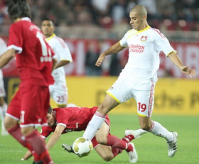

Methods
Calling Instance and Static Methods

Slide 29

Methods
Methods manipulate the data of the object to which they belong or perform other tasks
Examples:
Console.WriteLine(…)
Console.ReadLine()
String.Substring(index, length)
Array.GetLength(index)
List<T>.Add(item)
DateTime.AddDays(count)

Slide 30
Instance Methods
Instance methods manipulate the data of a specified object or perform any other tasks
If a value is returned, it depends on the particular class instance
Syntax:
The name of the instance, followed by the name of the method, separated by dot
<object_name>.<method_name>(<parameters>)

Slide 31
Calling Instance Methods – Examples
Calling instance methods of String:
Calling instance methods of DateTime:
String sampleLower = new String('a', 5);
String sampleUpper = sampleLower.ToUpper();
Console.WriteLine(sampleLower); // aaaaa
Console.WriteLine(sampleUpper); // AAAAA
DateTime now = DateTime.Now;
DateTime later = now.AddHours(8);
Console.WriteLine("Now: {0}", now);
Console.WriteLine("8 hours later: {0}", later);

Slide 32


Calling Instance Methods
Live Demo

Slide 33
Static Methods
Static methods are common for all instances of a class (shared between all instances)
Returned value depends only on the passed parameters
No particular class instance is available
Syntax:
The name of the class, followed by the name of the method, separated by dot
<class_name>.<method_name>(<parameters>)

Slide 34
Calling Static Methods – Examples
Constant field
Static method
using System;
double radius = 2.9;
double area = Math.PI * Math.Pow(radius, 2);
Console.WriteLine("Area: {0}", area);
// Area: 26,4207942166902
double precise = 8.7654321;
double round3 = Math.Round(precise, 3);
double round1 = Math.Round(precise, 1);
Console.WriteLine(
"{0}; {1}; {2}", precise, round3, round1);
// 8,7654321; 8,765; 8,8
Static method
Static method

Slide 35

Calling Static Methods
Live Demo

Slide 36
Constructors
Constructors are special methods used to assign initial values of the fields in an object
Executed when an object of a given type is being created
Have the same name as the class that holds them
Do not return a value
A class may have several constructors with different set of parameters

Slide 37
Constructors (2)
Constructor is invoked by the new operator
Examples:
<instance_name> = new <class_name>(<parameters>)
String s = new String(new char[]{'a','b','c'});
String s = new String('*', 5); // s = "*****"
DateTime dt = new DateTime(2009, 12, 30);
DateTime dt = new DateTime(2009, 12, 30, 12, 33, 59);
Int32 value = new Int32();

Slide 38
Parameterless Constructors
The constructor without parameters is called default (parameterless) constructor
Example:
Creating an object for generating random numbers with a default seed
Parameterless constructor call
using System;
...
Random randomGenerator = new Random();
The class System.Random provides generation of pseudo-random numbers

Slide 39
Constructor with Parameters
Example
Creating objects for generating random values with specified initial seeds
using System;
...
Random randomGenerator1 = new Random(123);
Console.WriteLine(randomGenerator1.Next());
// 2114319875
Random randomGenerator2 = new Random(456);
Console.WriteLine(randomGenerator2.Next(50));
// 47

Slide 40

Generating Random Numbers
Live Demo

Slide 41
More Constructor Examples
Creating a DateTime object for a specified date and time
Different constructors are called depending on the different sets of parameters
using System;
DateTime halloween = new DateTime(2009, 10, 31);
Console.WriteLine(halloween);
DateTime julyMorning =
new DateTime(2009,7,1, 5,52,0);
Console.WriteLine(julyMorning);

Slide 42

Creating DateTime Objects
Live Demo

Slide 43

Enumerations
Types Limited to a Predefined Set of Values

Slide 44
Enumerations
Enumerations in C# are types whose values are limited to a predefined set of values
E.g. the days of week
Declared by the keyword enum in C#
Hold values from a predefined set
public enum Color { Red, Green, Blue, Black }
…
Color color = Color.Red;
Console.WriteLine(color); // Red
color = 5; // Compilation error!

Slide 45


Enumerations
Live Demo

Slide 46
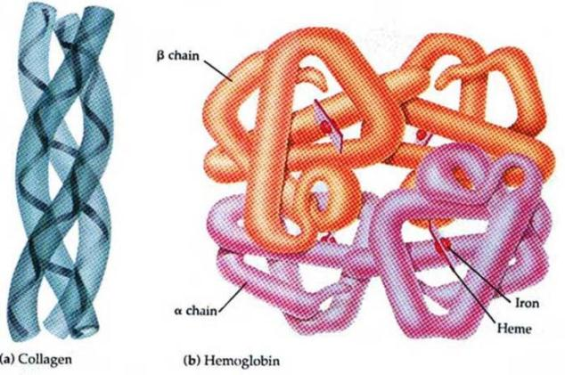
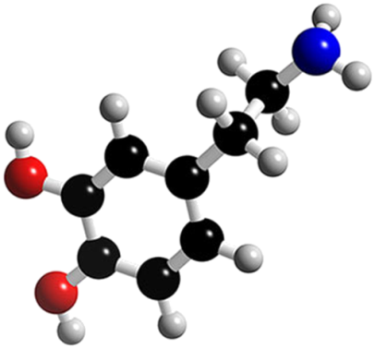
Structures
What are Structures? When to Use Them?

Slide 47
Structures
Structures in C# are similar to classes
Structures are value types (directly hold a value)
Classes are reference types (pointers)
Structures are usually used for storing data structures, without any other functionality
Structures can have fields, properties, etc.
Using methods is not recommended
Example of structure
System.DateTime – represents a date and time

Slide 48

Namespaces
Organizing Classes Logically into Namespaces

Slide 49
What is a Namespace?
Namespaces are used to organize the source code into more logical and manageable way
Namespaces can contain
Definitions of classes, structures, interfaces and other types and other namespaces
Namespaces can contain other namespaces
For example:
System namespace contains Data namespace
The name of the nested namespace is System.Data

Slide 50
Full Class Names
A full name of a class is the name of the class preceded by the name of its namespace
Example:
Array class, defined in the System namespace
The full name of the class is System.Array
<namespace_name>.<class_name>

Slide 51
Including Namespaces
The using directive in C#:
Allows using types in a namespace, without specifying their full name
Example:
instead of
using <namespace_name>
using System;
DateTime date;
System.DateTime date;

Slide 52




The Random Class
Password Generator Demo

Slide 53
The Random Class
The Random class
Generates random integer numbers
Random rand = new Random();
for (int number = 1; number <= 6; number++)
{
int randomNumber = rand.Next(49) + 1;
Console.Write("{0} ", randomNumber);
}
This generates 6 random int in range [1..49]
Always use a single Random instance!
This will avoid abnormalities

Slide 54
Password Generator – Example
Write a program to generate a random password between 8 and 15 characters
The password contains of at least two capital letters, two small letters, one digit and three special characters
Constructing the password generator class:
Start from an empty password
Place 2 random capital letters at random positions
Place 2 random small letters at random positions
Place 1 random digit at random positions
Place 3 special characters at random positions

Slide 55
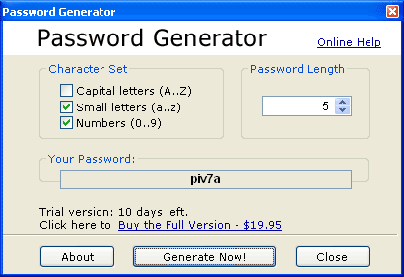

Password Generator (2)
Now we have exactly 8 characters
To make the password length between 8 and 15 we add between 0 and 7 random characters
Capital / small letters / digits / special character
Inserts each of them at random position

Slide 56
Password Generator Class
class RandomPasswordGenerator
{
private const string CapitalLetters=
"ABCDEFGHIJKLMNOPQRSTUVWXYZ";
private const string SmallLetters =
"abcdefghijklmnopqrstuvwxyz";
private const string Digits = "0123456789";
private const string SpecialChars =
"~!@#$%^&*()_+=`{}[]\\|':;.,/?<>";
private const string AllChars =
CapitalLetters + SmallLetters + Digits + SpecialChars;
private static Random rnd = new Random();
// the example continues…

Slide 57
Password Generator Class (2)
static void Main()
{
StringBuilder password = new StringBuilder();
for (int i = 1; i <= 2; i++)
{
char capitalLetter = GenerateChar(CapitalLetters);
InsertAtRandomPosition(password, capitalLetter);
}
for (int i = 1; i <= 2; i++)
{
char smallLetter = GenerateChar(SmallLetters);
InsertAtRandomPosition(password, smallLetter);
}
char digit = GenerateChar(Digits);
InsertAtRandomPosition(password, digit);
for (int i = 1; i <= 3; i++)
{
char specialChar = GenerateChar(SpecialChars);
InsertAtRandomPosition(password, specialChar);
}
// the example continues…

Slide 58
Password Generator Class (3)
int count = rnd.Next(8);
for (int i = 1; i <= count; i++)
{
char specialChar = GenerateChar(AllChars);
InsertAtRandomPosition(password, specialChar);
}
Console.WriteLine(password);
}
private static void InsertAtRandomPosition(
StringBuilder password, char character)
{
int randomPosition = rnd.Next(password.Length + 1);
password.Insert(randomPosition, character);
}
private static char GenerateChar(string availableChars)
{
int randomIndex = rnd.Next(availableChars.Length);
char randomChar = availableChars[randomIndex];
return randomChar;
}

Slide 59

.NET Common Type System
Brief Introduction

Slide 60
Common Type System (CTS)
CTS defines all data types supported in .NET Framework
Primitive types (e.g. int, float, object)
Classes (e.g. String, Console, Array)
Structures (e.g. DateTime)
Arrays (e.g. int[], string[,])
Etc.
Object-oriented by design

Slide 61
CTS and Different Languages
CTS is common for all .NET languages
C#, VB.NET, J#, JScript.NET, ...
CTS type mappings:
CTS Type | C# Type | VB.NET Type
System.Int32 | int | Integer
System.Single | float | Single
System.Boolean | bool | Boolean
System.String | string | String
System.Object | object | Object

Slide 62
System.Object: CTS Base Type
System.Object (object in C#) is a base type for all other types in CTS
Can hold values of any other type:
All .NET types derive common methods from System.Object, e.g. ToString()
string s = "test";
object obj = s;
DateTime now = DateTime.Now;
string nowInWords = now.ToString();
Console.WriteLine(nowInWords);

Slide 63
Value and Reference Types
In CTS there are two categories of types
Value types
Reference types
Placed in different areas of memory
Value types live in the execution stack*
Freed when become out of scope
Reference types live in the managed heap (dynamic memory)
Freed by the garbage collector
* Note: this does not mean that value types, which are part of reference types live on the stack. E.g., integers in a List<int> do not live on the stack

Slide 64
Value and Reference Types – Examples
Value types
Most of the primitive types
Structures
Examples: int, float, bool, DateTime
Reference types
Classes and interfaces
Strings
Arrays
Examples: string, Random, object, int[]

Slide 65
Value and Reference Types
int intNum = 5;
DateTime date = DateTime.Now;
int[] intArr = new int[] {5, 6, 7};
string str = "telerik";
Stack
Heap
intNum (4 bytes)
int[3] (20 bytes)
5
b8 28 80 5d 03 00 00 00 05 00 00 00 06 00 00 00 07 00 00 00
dateTime (8 bytes)
17.01.2012 13:39
intArr (4-byte pointer)
string (22 bytes)
0214e058
2c f9 7f 5d 07 00 00 00 74 00 65 00 6c 00 65 00 72 00 69 00 6b 00
str (4-byte pointer)
024e4df4

Slide 66

Summary
Classes provide the structure for objects
Objects are particular instances of classes
Classes have different members
Methods, fields, properties, etc.
Instance and static members
Members can be accessed
Methods can be called
Structures are used for storing data
Namespaces group related classes

Slide 67

Summary (2)
Namespaces help organizing the classes
Common Type System (CTS) defines the types for all .NET languages
Values types
Reference types

Slide 68
Using Classes and Objects
http://csharpfundamentals.telerik.com

Slide 69
Exercises
Write a program that reads a year from the console and checks whether it is a leap. Use DateTime.
Write a program that generates and prints to the console 10 random values in the range [100, 200].
Write a program that prints to the console which day of the week is today. Use System.DateTime.
Write methods that calculate the surface of a triangle by given:
Side and an altitude to it; Three sides; Two sides and an angle between them. Use System.Math.

Slide 70
Exercises (2)
Write a method that calculates the number of workdays between today and given date, passed as parameter. Consider that workdays are all days from Monday to Friday except a fixed list of public holidays specified preliminary as array.
You are given a sequence of positive integer values written into a string, separated by spaces. Write a function that reads these values from given string and calculates their sum. Example:
string = "43 68 9 23 318" → result = 461

Slide 71
Exercises (3)
* Write a program that calculates the value of given arithmetical expression. The expression can contain the following elements only:
Real numbers, e.g. 5, 18.33, 3.14159, 12.6
Arithmetic operators: +, -, *, / (standard priorities)
Mathematical functions: ln(x), sqrt(x), pow(x,y)
Brackets (for changing the default priorities)
Examples:
(3+5.3) * 2.7 - ln(22) / pow(2.2, -1.7) → ~ 10.6
pow(2, 3.14) * (3 - (3 * sqrt(2) - 3.2) + 1.5*0.3) → ~ 21.22
Hint: Use the classical "shunting yard" algorithm and "reverse Polish notation".

Slide 72


Free Trainings @ Telerik Academy
“C# Programming @ Telerik Academy
csharpfundamentals.telerik.com
Telerik Software Academy
academy.telerik.com
Telerik Academy @ Facebook
facebook.com/TelerikAcademy
Telerik Software Academy Forums
forums.academy.telerik.com

